Slide 1
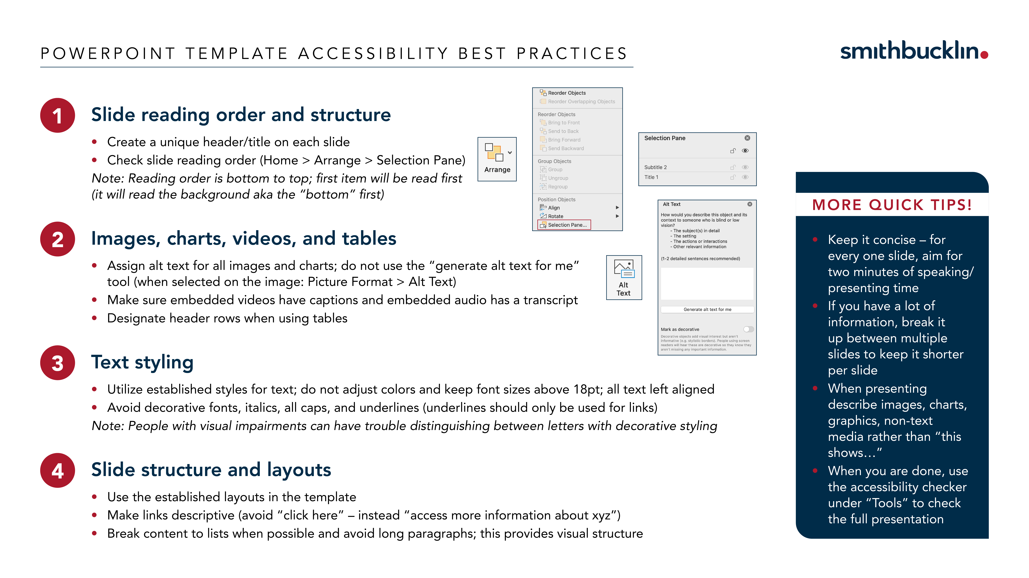


Slide 3
Presentation Header Goes Here and Can Span Up To Three Lines
Subtitle Information or Presenter Information Goes Here and Can Span Up To Four Lines If Needed

Slide 4
Section Header Information Here Can Span to Three Lines if Needed
Subtitle or other information can go here and can be up to three lines if needed

Slide 5
Page Title
Bullet One
Bullet Two
Bullet Three
Bullet Four
Bullet Five

Slide 6
Page Title
Bullet One
Bullet Two
Bullet Three
Bullet Four
Bullet Five
Bullet One
Bullet Two
Bullet Three
Bullet Four
Bullet Five

